Slide 1
Hazing in Greek Life
Jordan Barth

Slide 2
Greatest Hits
Phi Kappa Psi (Washington and Lee University)
Kappa Kappa Gamma (Dartmouth College)
Phi Kappa Alpha (Tulane University)
Notes:
Phi Kappa Psi (Fraternity)- used a Taser on a new member to punish and intimidate others
KKG (Sorority)- Blindfolded and while extremely intoxicated, pushed out of the car.
PIKE (Fraternity)- allegedly poured boiling water, vinegar, and crab boil on new members after covering them with flour and wasabi and cayenne pepper.
Yes, this incidents are mildly funny and could be pulled straight from Jackass. Hazing is serious. Just ask the Piazza’s (parents of an Penn State freshman) whose son died so senselessly in a fraternity house after hazing. Ask the countless young men and women who’ve been permanently traumatized from hazing. While outside of my research interests, this topic is very personal. I find it incredible that no centralized database of greek organizations that have been investigated or sanctioned – such a database could inform students and parents about the organizations on their campuses. No student should die from greek life, period.
Why does it occur? Long standing traditions that go way too far combined with alcohol-induced adolescent maturing throughout college combined with groupthink

Slide 3
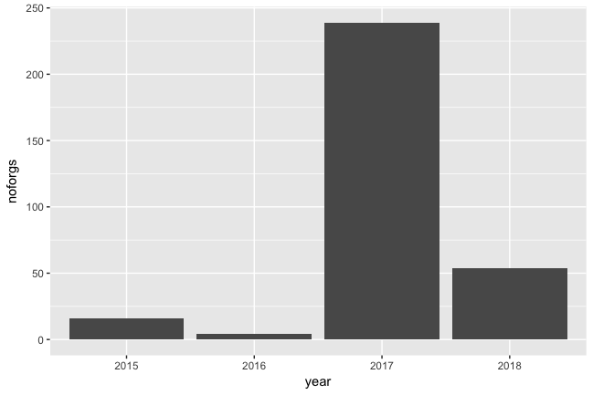
Hazing in Public Discussion
Notes:
Brought into public conversation due to the release of The Hunting Ground (looked at sexual assault and hazing in greek organizations and campuses more generally) and press coverage surrounding deaths of Tim Piazza at Penn State and Max Gruver at LSU
- 2015- 16 organizations were sanctioned
2016- 4
2017- 239
-2018- 54

Slide 4
Methodology
Current Data Set: n = 300+, Final Paper: n = 600+
Campus, Local, Regional and National Publications
Time of Interest: 2015-2018
Challenges
Notes:
Methodological challenges- While this only looks at hazing, heavy alcohol usage usually is part of hazing rituals, some universities consider it a separate violation others don’t. (same with health and safety)
No clearinghouse/data hub to pull information from -- all done by google search
Some universities post status of greek organizations but its often incomplete or quite scattere
Why 2015- The Hunting Ground

Slide 5
Defining the terminology
Cease and Desist
Social Probation
Disciplinary Probation
Suspension
Notes:
Operationalizing my variables here was difficult: each university sanctions greek life differently – as such, they have unique terminology and there exists no clear or agreed-upon definition, forcing me to reconcile with institutional nuances
Cease and Desist: Chapter under investigation are usually given temporary cease and desist orders, requiring the chapter to temporarily stop all activity, including member gatherings, recruitment events, social events, and new member meetings. Any necessary fraternity business meetings must be pre-approved by the OCL
Disciplinary Probation: New policy violations while the chapter is on probation can result in revocation. Organizations are permitted to conduct operations as usual unless additional modifications to operating status are made in the chapter outcome letter.
Social Probation: The organization is unable to host social events with alcohol. Social probation has no limit to minimum or maximum duration. Recruitment, new member education, educational events, and philanthropy events are allowed during social probation.
Suspension: The organization’s recognition is suspended by the University for a specified period of time. Further violations could result in the permanent revocation of the organization’s University recognition.
Revocation of Recognition: The organization must wait at least four years before reapplying for recognition

Slide 6
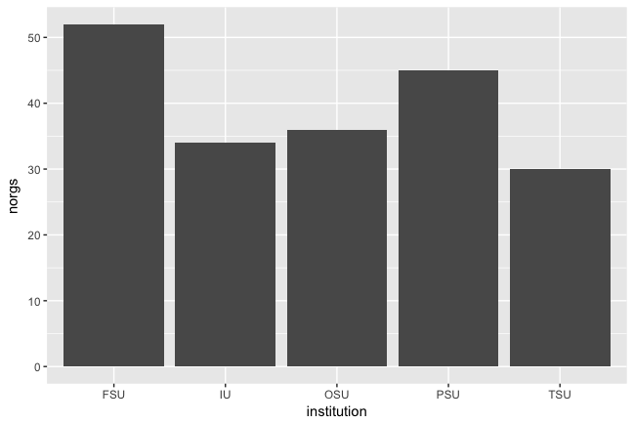
Sanctioned Organizations (by Campus)
Notes:
Missing LSU – Suspended entire greek life for short time
OSU and PSU now require organizations to reapply for recognitions with new conditions.
OSU: 52
PSU- 45
-OSU- 36
IU: 34
TSU: 30

Slide 7
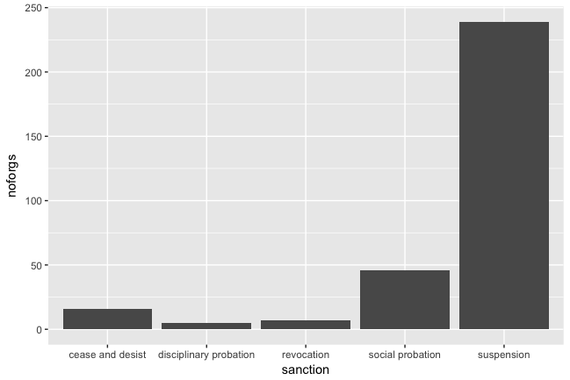
Sanctions
Notes:
Cease and desist: 16
Dis Probation
Social Probation: 46
Suspension: 239
Revocation: 7

Slide 8
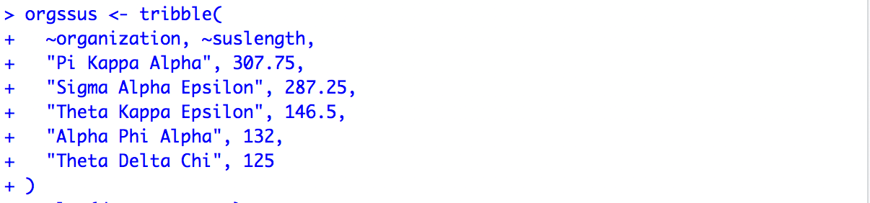
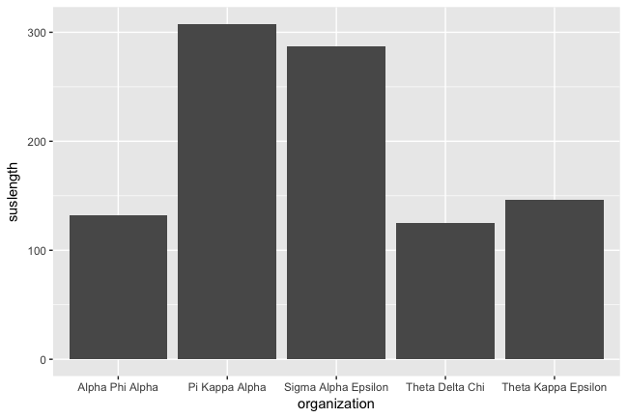
Suspension Length (by Greek Organization)
Notes:
Included top 5 here-
Pi Kappa Alpha: 307.75
SAE: 287.75
TKE: 146.5
Alpha Phi Alpha: 132
Theta Delta Chi: 125

Slide 9
In the Next Week…
Use lubridate and transform dates from characters
Add more observations
Create algorithm to calculate length of suspension
Dive into spatial data further

